Slide 1





21GIT
Cloud Computing

Slide 2


Member :
+Phùng Anh Sang
+Nguyễn Mạnh Trường Đạt
+Trương Bá Vương
+Nguyễn Thái Khánh Duy

Slide 3


1.DEFINITION
Cloud computing is the delivery of different services through the Internet. These resources include tools and applications like data storage, servers, databases, networking, and software.

Slide 4
Five Essential Characteristics
On-demand self-service.
Users can provision computing resources independently
without manual intervention.
4
Rapid elasticity
Resources can quickly scale to match changing needs.
1
1
2
Broad network access.
Cloud services are accessible via the internet on various devices.
Measured service
Usage is monitored, optimized, and transparently reported for tracking and billing.
5
3
Resource pooling.
Providers share and allocate resources based on consumer demand.
Notes:
Cloud computing is characterized by:
On-Demand Self-Service: Users can provision computing resources independently without manual intervention.
Broad Network Access: Cloud services are accessible via the internet on various devices.
Resource Pooling: Providers share and allocate resources based on consumer demand.
Rapid Elasticity: Resources can quickly scale to match changing needs.
Measured Service: Usage is monitored, optimized, and transparently reported for tracking and billing.

Slide 5
How it work?
Cloud computing works by having companies host or maintain massive data centers that provide the security, storage capacity and computing power to support cloud infrastructure
Clients pay for the rights to use their clouds along with an ecosystem to communicate between devices and programs

Slide 6


Architecture
Frontend
Backend
Graphical User Interface(GUI)
Client Infrastructure
Application
Service
Runtime Cloud
Storage
Security
Internet
Database
Analytics
and
Notes:
Cloud architecture comprises Frontend and Backend components:
1. Frontend:
- User/client side of the cloud system.Includes interfaces and applications for accessing cloud resources.
- Client Infrastructure provides graphical interfaces for interaction.
2. Backend:
The cloud itself managed by service providers.Encompasses resources, management, and security.Includes storage, virtual applications, and more.
Offers applications and services (SaaS, PaaS, IaaS).Provides runtime platforms, scalable storage, infrastructure, and security.
- Internet connects frontend and backend.
- Manages structured data storage (databases) and networking infrastructure.
- Supports data analytics (warehousing, BI, machine learning).

Slide 7
Cloud computing vs database
Criteria
Database
Cloud
Storage location
On local hardware or servers in an organization's own data center
On the cloud computing infrastructure of a cloud service provider
Scalability
Limited scalability and must upgrade physical infrastructure
Provides flexible scalability by increasing server resources
Data management
All aspects of the database themselves, including backups, security, and performance management
Provides cloud-based management services that reduce data management work
Efficiency
Requires specialized knowledge and servicing resources
Provides centralized management services that can be pre-optimized to ensure good performance

Slide 8
Cloud computing vs database
Criteria
Database
Cloud
Expense
Require high initial investment in infrastructure and costs related to data management
avoid large initial investment costs and instead pay based on a pay-as-you-go model
Update
require significant time and resources
easy

Slide 9

3. Cloud Deployment Models
Public Cloud
Private Cloud
Community Cloud
Hybrid Cloud

Slide 10
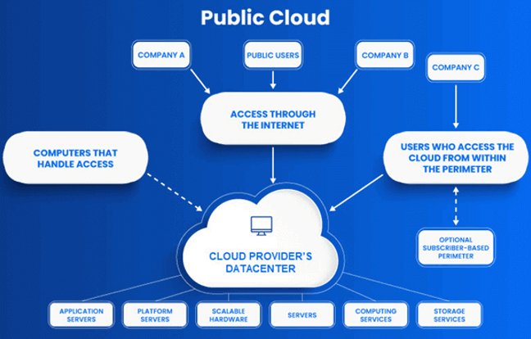
Public Cloud
Defination
Accessible to a wide range of users
Resources are shared between all users
Usually hosted by third-party providers

Slide 11
Public Cloud
Application
Scalability
Cost-Efficiency
Development and Testing
Notes:
- Scalability: Organizations can quickly scale up or down resources as needed, making it suitable for businesses
- Cost-Efficiency: Public clouds often follow a pay-as-you-go model, dont need to pay for a whole on premise datacenter
- Development and Testing: Developers can use public clouds for creating and testing applications more easier.

Slide 12
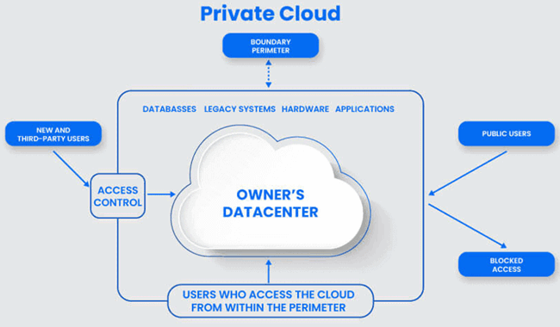
Private Cloud
Defination
Dedicated to a single organization
Don’t share the hardware
Greater control and privacy.

Slide 13
Private Cloud
Application
Security and Compliance
Customization
Notes:
- Security and Compliance: Industries such as healthcare and finance choose private clouds to maintain strict data security and regulatory compliance.
- Customization: Private clouds allow organizations to modify their infrastructure to suit specific business needs.

Slide 14
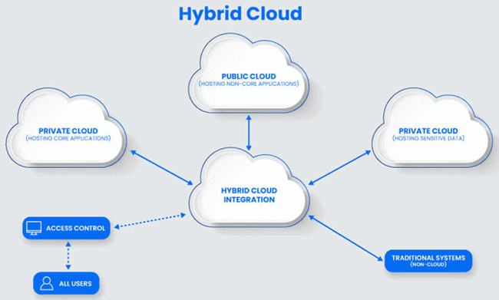
Hybrid Cloud
Defination
Combines public and private clouds
Uses the public cloud but owns on-premises systems

Slide 15
Hybrid Cloud
Application
Workload Flexibility
Recovery
Notes:
- Workload Flexibility: Use the public cloud to handle normal works, while keeping critical data and applications in a private cloud.
- Recovery: Data backup, recovery, and business continuity are facilitated

Slide 16
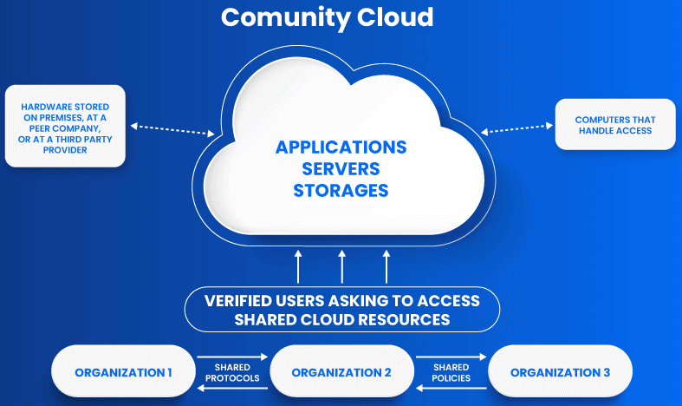
Community Cloud
Defination
Enable multiple organizations to share resources and services

Slide 17
Community Cloud
Application
Cost Sharing
Data Collaboration
Notes:
- Cost Sharing: Organizations within the community can invest in together and benefit from shared cloud resources.
- Data Collaboration: Exchange data safely and collaborative projects are in a trusted community.

Slide 18
4. Application Methods
4
1
Serverless Computing
1
IaaS
PaaS
5
2
Edge Computing
SaaS
3

Slide 19
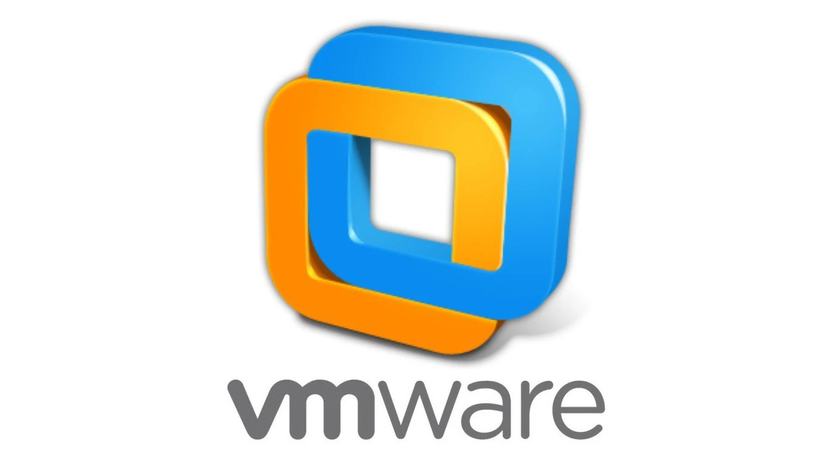
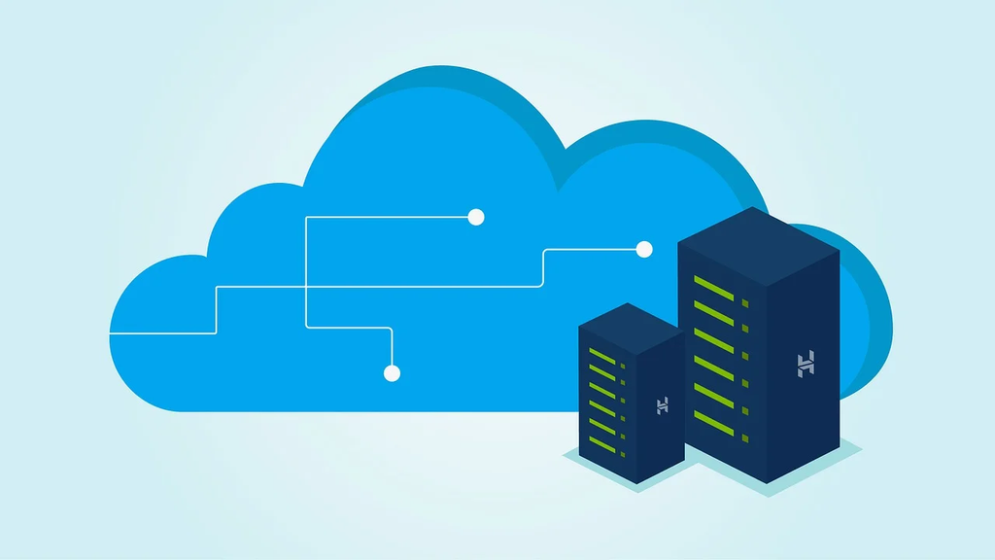
IaaS (Infrastructure as a Service)
Defination
Offers virtualized infrastructure resources on a pay-as-you-go basis.
Virtual Machines
Scalable Web Hosting

Slide 20
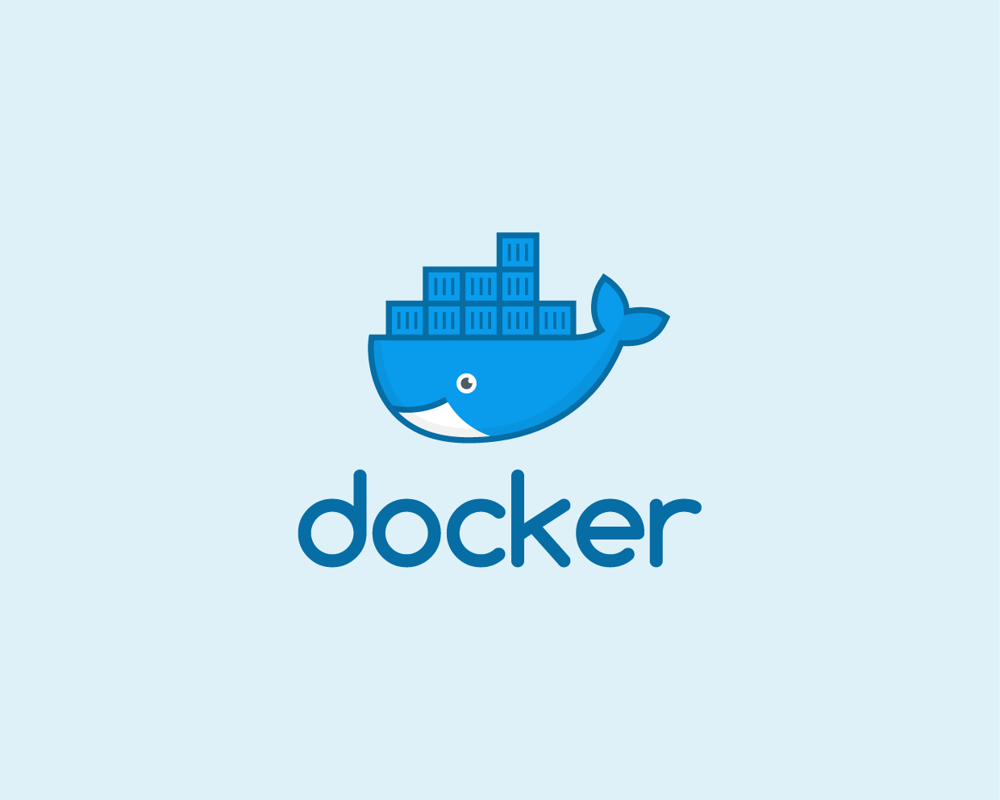
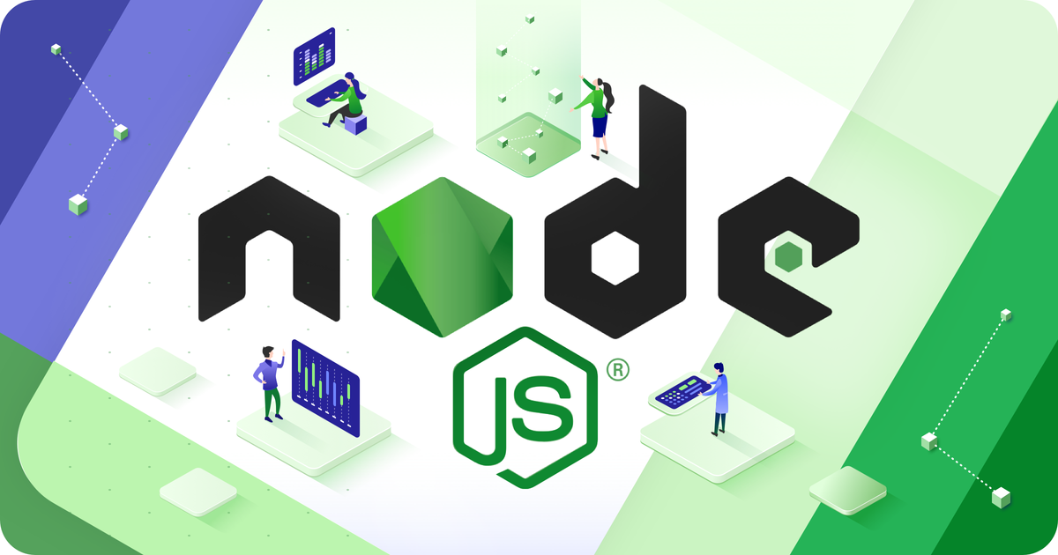
PaaS (Platform as a Service)
Defination
Offers a platform for application development and deployment
Application Development

Slide 21
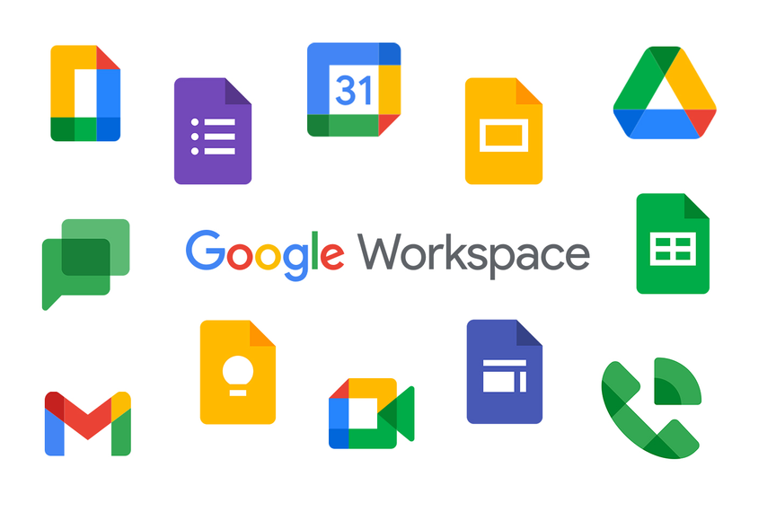
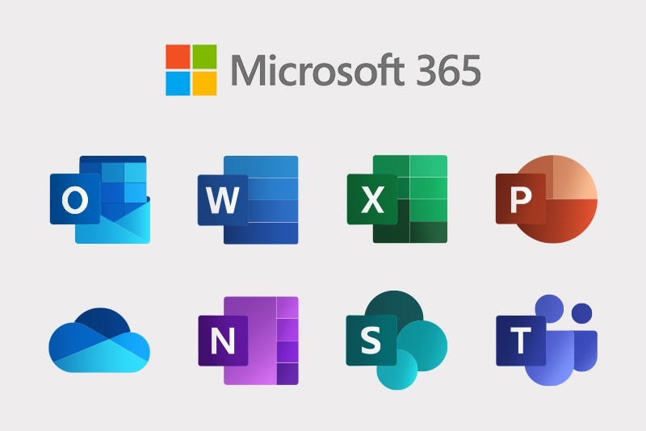
SaaS (Software as a Service)
Defination
Delivers software applications over the internet.
Google Workspace
Microsoft 365

Slide 22
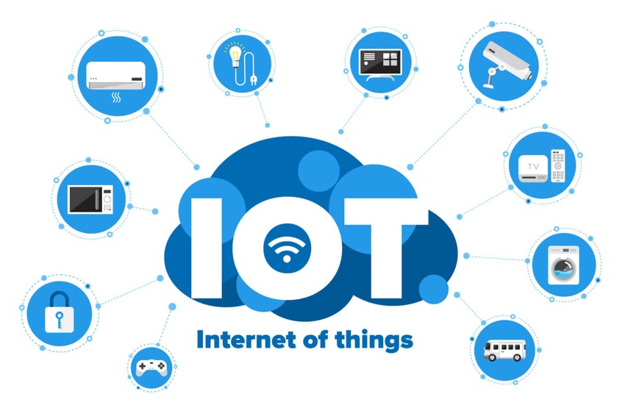

Serverless Computing
Defination
Allows developers to run code in response to events without managing servers.
Internet of thing
Image and Video Processing

Slide 23
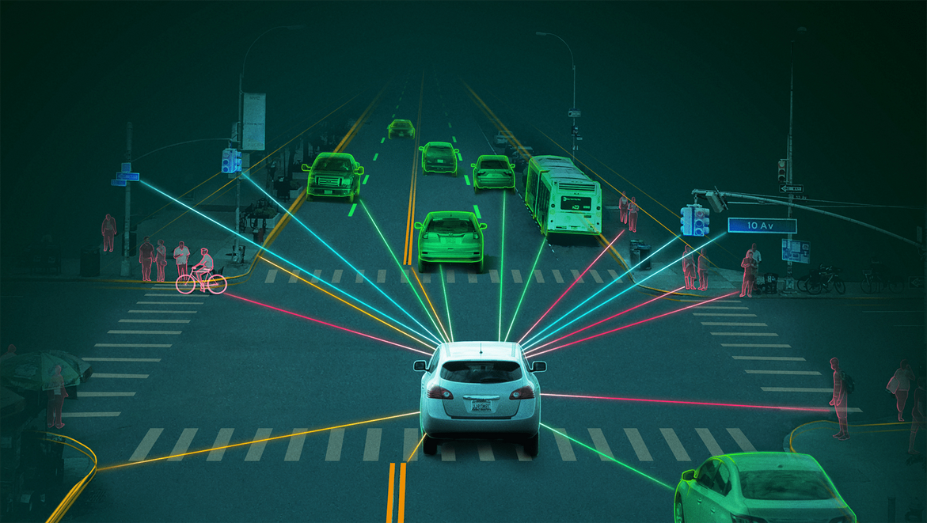
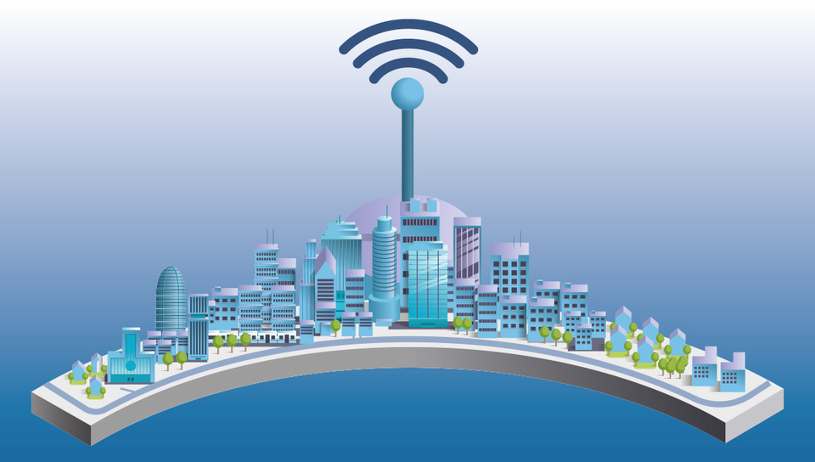
Edge Computing
Defination
Processes data closer to the data source, reducing latency and enabling real-time processing.
Autonomous Vehicles
Smart Cities

Slide 24
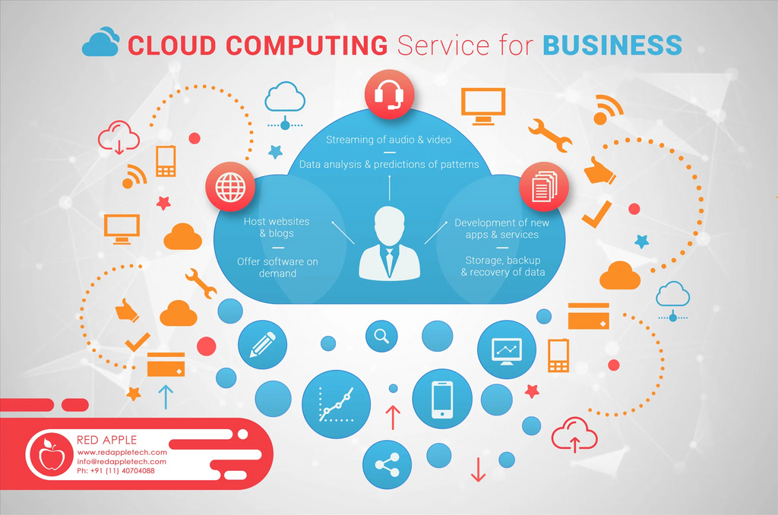
5.Benefits for businesses when accessing cloud computing
1
1
Cost Savings
Deploy and upgrade information infrastructure more easily
2
3
No effort or human resources needed to build an IT system and operate it
Notes:
Benefits for businesses when accessing cloud computing:
- Cost savings
For example: Instead of a business investing in information infrastructure that is very large and expensive and cannot be fully used from the beginning, the business can rent cloud computing services, the business will pay monthly and use it. Use according to actual needs, pay as much as you use
- Deploy and upgrade information infrastructure more easily
- When using cloud computing, businesses will not waste effort and human resources to build IT and exploitation systems
→ No need to worry about exploitation, then operating and exploiting is the service provider's job.
Risks when accessing cloud computing:Whether a business uses a traditional database or cloud computing when it comes to information security, businesses must pay attention to three factors:
- Tools
- Human
- Procedure
→ When businesses choose service providers, they must require service providers to have commitments on information security as well as SLA (Service Level Agreement) to have a basis for communication with customers. future service providers

Slide 25

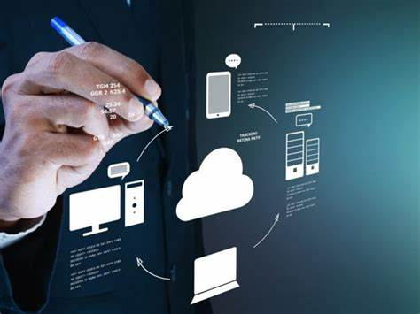
6.The Applications That Cloud Computing Brings
Store and share data
Big data analysis
Backup and restore data
Business management application
Notes:
Data Storage and Sharing: Cloud computing provides the ability to store data for users, and devices connected to the internet can easily access and edit it. This enables remote work as tasks can be performed from anywhere with just a computer and internet access.
Big Data Analytics: Big data analysis is a crucial and beneficial application of cloud computing for businesses. It involves analyzing structured and unstructured data, such as customer data, sales performance, and market trends. Using cloud computing simplifies the process of analyzing large datasets for businesses without incurring significant costs.
Backup and Data Recovery: Traditional backup solutions can be time-consuming, susceptible to viruses, prone to data loss, and expensive for businesses. Cloud-based backup and recovery provide an optimal solution to overcome these limitations. It not only maximizes data availability but also simplifies the process. Additionally, some cloud computing services offer scheduled backups and encryption to protect against cyber threats.
Business Management Applications: Cloud computing combined with business management applications, such as Customer Relationship Management (CRM) and Enterprise Resource Planning (ERP), helps create effective and suitable management strategies. These applications are deployed using Software-as-a-Service (SaaS) models, primarily based on cloud computing, ensuring the maintenance, security, and management of essential business resources.

Slide 26



